Slide 1
Decision Tree Modeling in R
Decision Modeling in R workshop
July 2020

Slide 2
Building Decision Models in R
Notes:
Eline

Slide 3
Decision Tree (a type of model)
Schematic representation of all of the important outcomes of a decision (e.g., clinical, economic, non-health sectors)
Used to combine knowledge about decision problem from many sources
Computes average outcomes (e.g., costs, events, QALYs) from decisions

Slide 4
Components of a decision tree
The alternative strategies of a decision making process
The events that follow from application of any of these strategies and their likelihood
The outcomes (for an individual, a cohort or a population)

Slide 5
Structure of a decision tree
A tree consists of 3 different types of nodes connected via branches:
A decision tree starts with a decision node, which represents the choices a decision maker has between mutually exclusive strategies
A chance node represents possible events that could occur following a decision or a previous event. We include probabilities of these events in the tree.
A terminal node represents end points of each complete branch and the outcome associated with it.

Slide 6
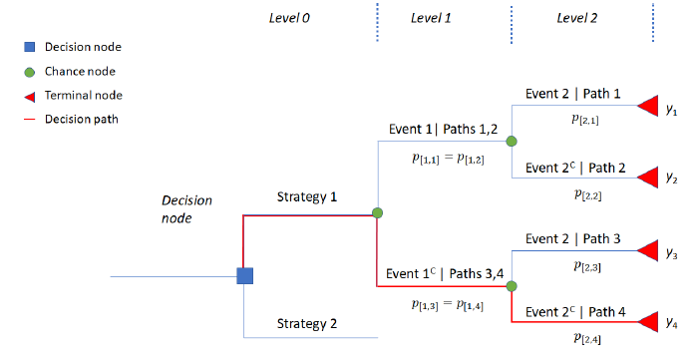
Plot of a sample decision tree

Slide 7
Compute average outcomes
The expected value (average) of the outcomes (i.e. cost, QALYs) of a strategy in a decision tree can be calculated by using the below steps:
Identify all branches in this strategy
Multiply all conditional probabilities in a branch
The product of all conditional probabilities is then multiplied with the outcome value of that branch
Repeat steps 2 and 3 for each branch
Sum (the product of conditional probabilities x outcome) for all branches under this strategy

Slide 8
Compute average outcomes – in R
The steps to calculate expected outcome(s) could be done easily in R in the following way:
Store the product of all conditional probabilities of each branch in a vector
Store the associating outcomes in a vector
Take the product of the two vectors using matrix multiplication.

Slide 9
Simple Decision Tree
Viral encephalitis can be caused by herpes virus (HVE) or other viruses (OVE); Pr(HVE) = 52%.
Untreated HVE leads to severe sequelae in 71%; for OVE the figure is 1%.
A drug, vidarabine, decreases severe sequelae due to HVE from 71% down to 36%.
Side effects cause an increase in severe sequale among OVE patients treated with vidarabine from 1% to 20%.

Slide 10
To treat or not to treat
HVE
0.36
0.52
Treat
0.48
OVE
0.20
HVE
0.71
0.52
Do not treat
0.48
OVE
0.01
Outcome = Pr(severe sequelae)

Slide 11
0.52*0.36 + 0.48*0.20 = 0.2832
HVE
0.36
0.52
Treat
0.48
OVE
0.20
HVE
0.71
0.52
Do not treat
0.48
OVE
0.01

Slide 12
0.52*0.36 + 0.48*0.20 = 0.2832
HVE
0.36
0.52
Treat
0.48
OVE
0.20
HVE
0.71
0.52
Do not treat
0.48
OVE
0.01
0.52*0.71 + 0.48*0.01 = 0.3740

Slide 13
There is a third option
It is possible to obtain a definitive diagnosis by means of brain biopsy, but this procedure itself carries a risk of mortality of 0.5%.

Slide 14
0.2832
HVE
0.36
0.52
Treat
0.48
OVE
0.20
0.3740
HVE
0.71
Do not treat
0.52
0.48
OVE
0.01
Biopsy

Slide 15
0.2832
HVE
0.36
0.52
Treat
0.48
OVE
0.20
0.3740
HVE
0.71
Do not treat
0.52
0.48
OVE
0.01
Survive
Biopsy
0.995
0.005
Biopsy death

Slide 16
0.2832
HVE
0.36
0.52
Treat
0.48
OVE
0.20
0.3740
HVE
0.71
0.52
Do not treat
0.48
OVE
0.01
HVE
0.36
Survive
0.52
Biopsy
0.995
0.48
OVE
0.01
0.005
Biopsy death
1.00

Slide 17
0.2832
HVE
0.36
0.52
Treat
0.48
OVE
0.20
0.3740
HVE
0.71
0.52
Do not treat
0.48
OVE
0.01
0.1920
HVE
0.36
Survive
0.52
Biopsy
0.995
0.48
OVE
0.01
0.005
Biopsy death
1.00

Slide 18
0.2832
HVE
0.36
0.52
Treat
0.48
OVE
0.20
0.3740
HVE
0.71
0.52
Do not treat
0.48
OVE
0.01
0.1920
0.1919
HVE
0.36
Survive
0.52
Biopsy
0.995
0.48
OVE
0.01
0.005
Biopsy death
1.00

Slide 19
R Session
Notes:
Part 1 = Showing code 3 state model
Part 2 = Exercise build Sick-Sicker model
Part 3 = Show answers of Sick-Sicker

